Slide 1

FairPAN – Achieving fairness through neural networks
Author: Hubert Ruczyński
Mentor: Jakub Wiśniewski
Notes:
Good morning, I am Hubert Ruczyński and this talk is an effect of an amazing opportunity which I’ve grabbed during the previous summer. For two months I’ve gained my first scientific experience during MI2 DataLab Internship where I could work along much more experienced researchers and I’m really grateful for that possibility. Thanks to the people like my mentor Jacob Wiśniewski I’ve managed to generate enough will to go out of my comfort zone and participate in this project.

Slide 2


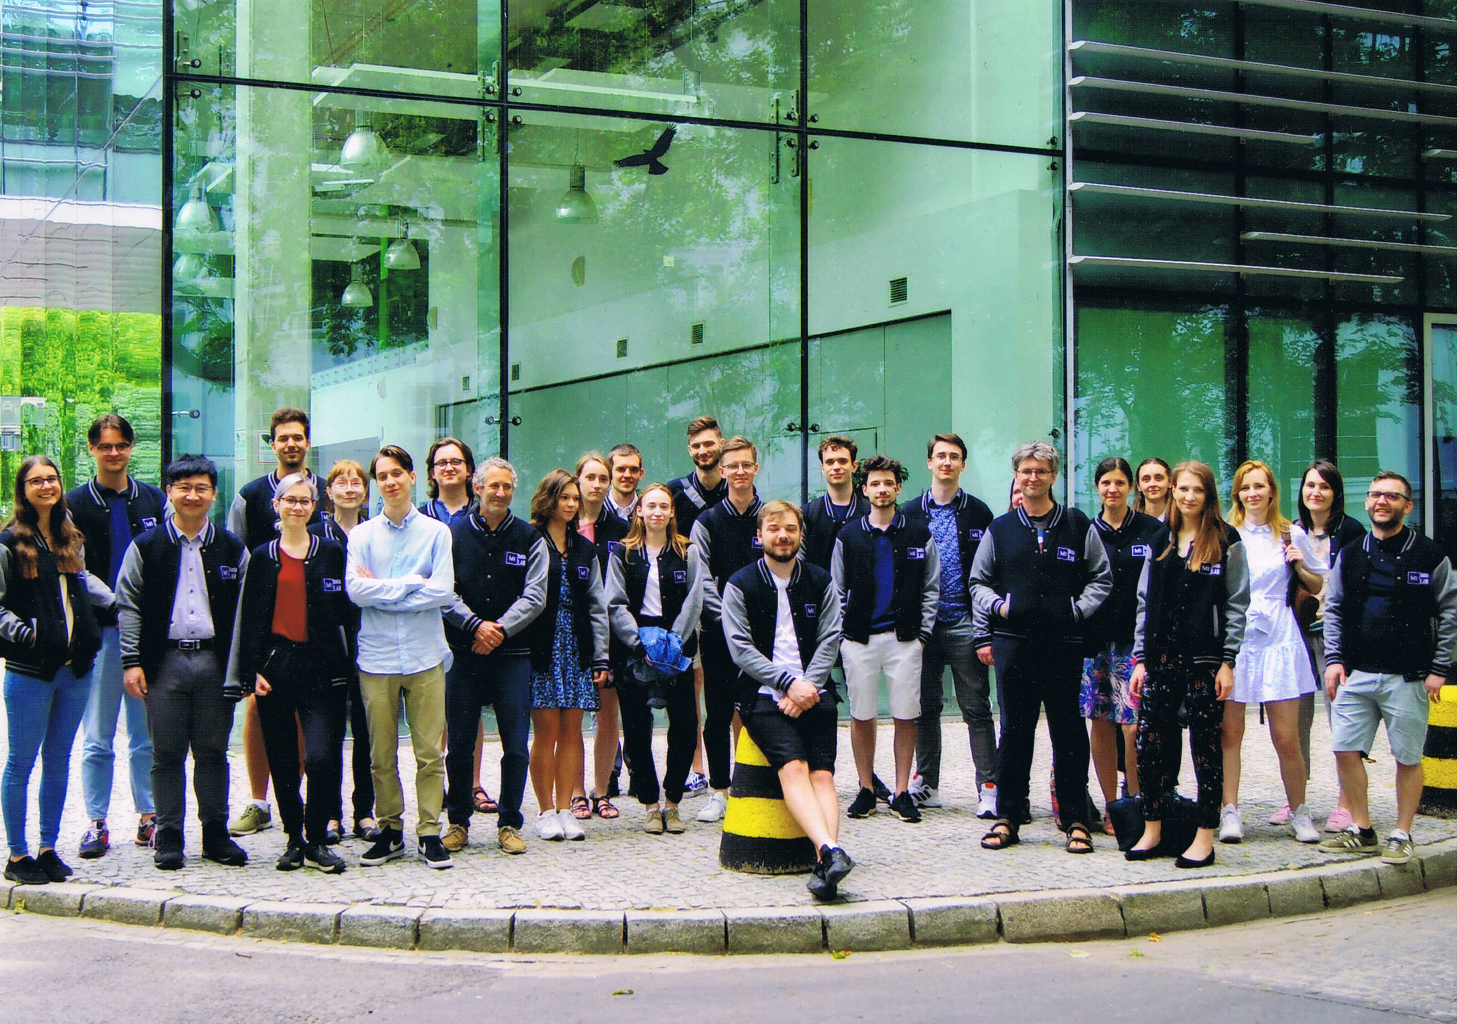
About Me
Work Experience:
MI2DataLab Internship 2021
R Package Developer
MAIR project
Studies:
Engineering and Data Analysis, MiNI, Warsaw University of Technology
Notes:
As I’ve mentioned before, during the summer I’ve become the part of MI2 Data Lab and that was my first work and scientific experience.
I’ve also become an R package developer after the implementation of FairPAN.
Right now, I’m participating in the MAIR project which is also MI2 Data Labs initiative and our goal is to track and analyse Europeans regulations about Artificial Intelligence.
I also study engineering and data analysis at the Warsaw University of Technology where I’m on 6th semester of engineer's degree and of course I don’t plan to stop after obtaining engineers title.

Slide 3
Presentation plan
Introduction
About Fairness
About GANs
Concept of FairPAN
Why is FairPAN great?
Performance and outcomes
Package workflow
Notes:
Now, I’d like to present you the outline of this talk.
At the very beginning I’ll make a short, abstract-like, introduction to this project.
Later I’m gonna talk about two important subjects, which you have to be familiar with before introducing the FairPAN. The first one is the concept of fairness followed by the simple example of it. The second one is about GANs and introduction to them.
After that I’ll talk about how FairPAN works and why it is so good.
I’m also going to prove that point by performance visualizations.
In the end I’ll talk a bit about FairPAN package and its workflow.
So, now without any further adeus, let’s get to the main subject.

Slide 4
FairPAN – simplified architecture
FairPAN
Zero-sum game
Biased tabular data
Classifier
(Predictor)
Adversarial
Fair predictions
Generator
Originally in
GAN
Notes:
The main topic of our study was the implementation and further research in the area of obtaining fair tabular data classifiers with the usage of neural networks. To achieve such results, we modify the idea of GANs by swapping the generator with the classifier and adapting the adversarial to recognize the label of a sensitive value. This way, FairPAN, which stands for Fair Predictive Adversarial Network, should bring us much fairer predictions. As a result, we present a mitigation technique suitable for neural networks and explore this field even more.

Slide 5
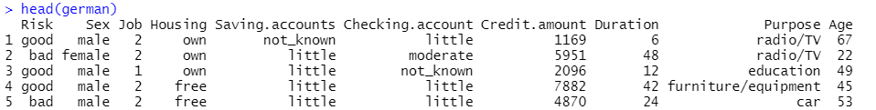
Unfairness example
Target (y)
Sensitive variables
https://www.propublica.org/article/machine-bias-risk-assessments-in-criminal-sentencing
Notes:
At the beginning I’d like to introduce you to the concept of fairness.
Consider the idea of the algorithm that has to predict whether giving credit to a person is risky or not. It is learning on real data of giving credits, for example german credit data, which were historically biased against females. In that case, the model learns this bias, which is not only included in the simple sex variable but also is hidden inside other variables, so removing this feature doesn’t make the model fair. As a result the classifier is more reluctant to give credits to women even if every other condition is similar to the one’s of man.
Other examples where this kind of bias is visible can be connected to the race or skin color of the person. One of the most known examples refers to the COMPAS algorithm which was used by American judges to define the likelihood of recidivism of the prisoners. As the intuition might guide you, it was heavily biased against black inmates who were twice as likely to be misclassified as being high risk in comparison to white inmates. The violent recidivism analysis also showed that even when controlling for prior crimes, future recidivism, age, and gender, black defendants were 77 percent more likely to be assigned higher risk scores than white defendants.
To read more about this particular case, I encourage you to search for propublicas article about it.

Slide 6




When do we use fairness?
Icons created by Freepik
Notes:
But now let’s move to more day-to-day example where we could use fairness.
Let’s imagine that we are the director of the bank which uses such model. Personally we are fully behind the equal treatment of men and women,
but on the other hand we have a biased model and we don’t even know about it. In such situations, fairness proves that it is a really important part of Explainable AI.

Slide 7
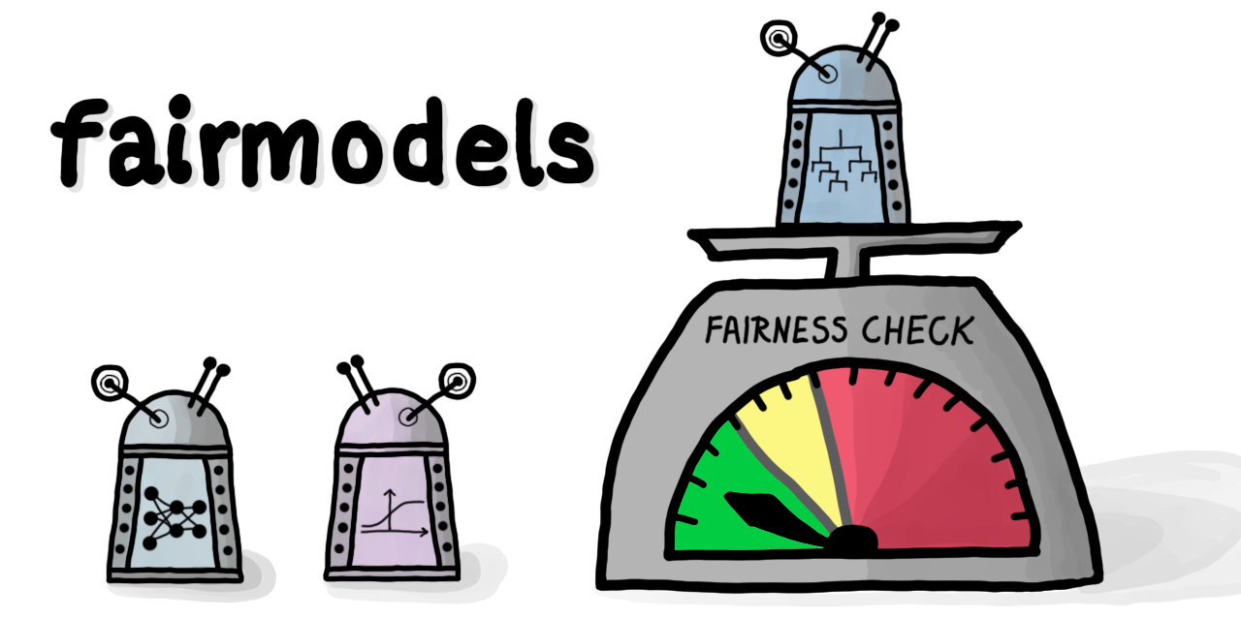
What is fairness?
`Fairness is a concept which focuses on bias detection and mitigation in order to achieve outcomes fair in the understanding of the user`
Notes:
The concept of fairness is sometimes really foggy, because we can’t always say if some variable leads to the bias of the model or is it just a good predictor, so I’d like to introduce you to my intuition behind it. I personally perceive fairness more like a tool to make your models suit to yours personal believes or we can even say that we want to make them politically correct.
In other words: `Fairness is a concept which focuses on bias detection and mitigation in order to achieve outcomes fair in the understanding of the user`.

Slide 8
GAN architecture
GAN
Punish Generator
Noised Data
Fake Data
Generator
Correct
Real Data
Adversarial
(Discriminator)
Real or Fake?
Notes:
Before we can move on to the idea of Fairpan, I have to introduce you to the concept of GANs, which stands for Generative Adversarial Networks. It is important to understand that, because our solution is strongly inspired by the behaviour of GANs.
Generative Adversarial Networks are two neural networks that learn together. The Generator has to generate new samples that are indistinguishable from original data and the adversarial, has to distinguish if the observation is original or generated. The generator is punished whenever the adversarial makes the correct prediction. After this zero-sum-game, the generator eventually learns how to make indistinguishable predictions and adversaries' accuracy drops down to 50% when a model cannot distinguish the two classes, which indicates that generated Fake data is almost the same as Real data.
This concept is connected to two facts that are worth noticing. Firstly, GANs are most commonly used to generate indistinguishable pictures, but we can also use them to tabular data, what happens in FairPAN. Secondly the accuracy drop of the Discriminator happens despite it is learning and improving in its classification task, so we don’t make it worse deliberatly.

Slide 9
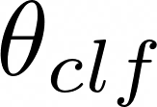



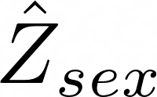
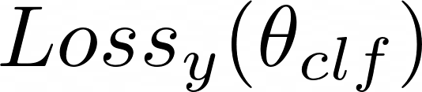
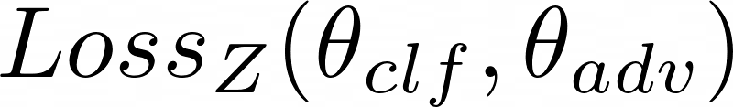
FairPAN architecture
Classifier
Adversarial
Notes:
Well, now as we finally know what fairness and GANs are, I can tell you more about FairPAN.
FairPANs are our solution to bring fairness into neural networks. We mimic the GANs by subsetting generator with classifier and the adversarial has to predict the sensitive value Z only from the output of the predictor y_hat, which is a vector of probabilities. Similarly to GANs, this zero-sum game is continued to the point when the adversarial cannot distinguish between two sensitive classes. In other words, it leads to the moment where information about sensitive value is greatly diminished or even lost and it means that our model makes fair predictions.

Slide 10
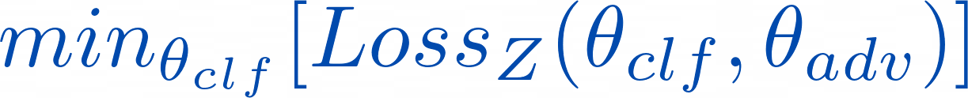
Custom Loss Function
Classifier:
Adversarial:
Notes:
The crucial part of this model is the metric that we use to engage the two networks into a zero-sum game, which is captured in the following function.
So, the model learns to minimize its prediction losses while maximizing that of the adversarial, due to lambda being positive and minimizing a negated loss is the same as maximizing it. The objective during the game is simpler for the adversarial, because it only has to predict sensitive value based on the classifiers output and this one is captured here:
The adversarial does not care about the prediction accuracy of the classifier. It is only concerned with minimizing its own prediction losses, so during the whole process it tries to get better at classifying the sensitive variable.

Slide 11
Training process
1. Pretrain both classifier and adversarial
Use a balanced dataset
Adversarials input is a single vector of probabilities
2. Fairtrain both models in a zero-sum game
Train adversarial
Provide loss to the classifier
Train classifier on a single, random minibatch
Repeat untill satisying outcome
Notes:
Now I’d like to describe the training process shortly.
Firstly we pretrain classifier and adversarial on a balanced dataset. Unfortunately we need to have similar amount of privileged and discriminated observations for the adversarial to work. After all it makes class prediction based on vector of probabilities only.
Later we begin the proper PAN training with both networks: we train the adversarial, provide its loss to the classifier, and after that we train the classifier on a single, random minibatch. We repeat this process desirable amount of times and after that we should get predictions which are indeed fair.

Slide 12
FairWHY ?
Notes:
At his point you might have asked yourselves a really important questions. Why do we want to use such complex mitigation technique, rather than use some other, well known methods ? Why do we even want to use fairpan package for that task?

Slide 13
FairWHY?
Smaller performance loses in comparison to regular methods
High flexibility of the package
Outcomes compatibile with DALEX and fairmodels
Intuitive and clean package workflow
Notes:
Well, regular mitigation techniques tend to worsen performance of the classifier by decreasing accuracy for example, whereas FairPAN has no such drawback and worsening of the performance is smaller.
Moreover, the package itself is very flexible because it enables not only to provide your own neural networks, but also to create one with our functions.
The outcomes are also created with the usage of DALEX and fairmodels, so one can use their methods and visualizations.
Additionally the workflow of the package is really simple and clean, because of multiple features available for users, such as preprocess function.

Slide 14
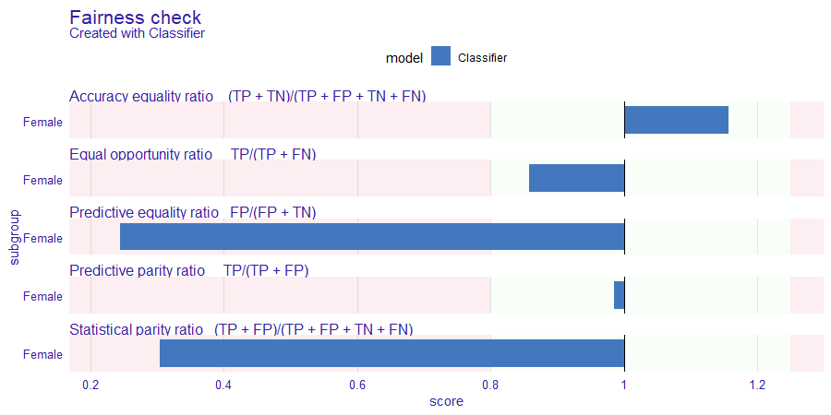
Fairness check metrics and pretrain Classifier
Notes:
At this point I’d like to introduce you to some graphical examples of how FairPAN works, which includes knowledge about some metrics used to measure fairness. The example I’m going to use comes from adult dataset where the classification task is to guess whether a person earns more or less than 50 thousand per year.
Presented visualization comes from the package fairmodels, written by Jacob Wiśniewski and it represents 5 metrics which are most interesting for the creator. I can agree with this set of metrics, because they are able to give us enough intuition about what is really happening in our data.
On this plot we actually see the ratios between discriminated group of Females to privileged group of Man in forementioned metrics. We assume that the model is fair according to the particular metric when it satisfies the 4/5 rule. The 4/5 rule is satisfied when both labels' in a sensitive class get similar results, which is between 4/5 and 5/4. On the plot it is visualized as a green background color between the red ones.
Now, as we know how to read such plots, I want to underline that the most important metric for us is the Statistical Parity Ratio, called STP shortly. It is so valuable, because it describes the similarity between distributions of our sensitive variables.
As you can see, after the pretrain stage, our model is performing quiet poorly in terms of fairness, because its STP ratio equals only 0.3 and other metrics behave poorly either.

Slide 15
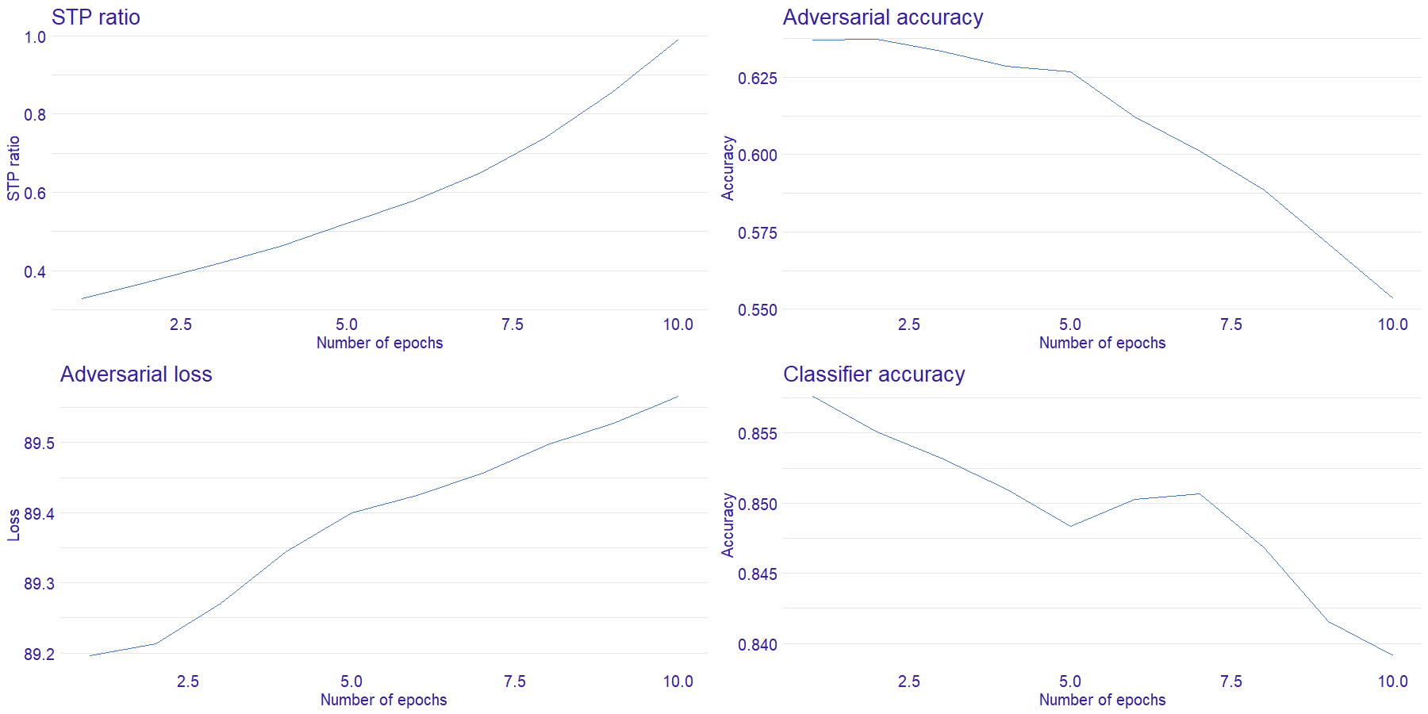
Monitored learning metrics
Notes:
To check if our model works properly, we've decided to track the four most important learning metrics which are: loss and accuracy of the adversarial model, accuracy of the classifier and of course STP ratio itself. These statistics indicate if the model is learning well and makes desirable progress.
As you can see, adversaries loss function grows and its accuracy diminishes which means that adversarial is worse with every iteration. We can also say that the classifier makes fairer predictions, because the adversary can't say which label is which.
Last, but not least, STP ratio also grows towards the 0.8-1.25 range which directly means that predictions are fairer.
As we can see from the last plot, accuracy of the classifier diminishes with every epoch, however this loss is really small and after all we gain much fairer model whilst sacrificing only 2% of accuracy.

Slide 16
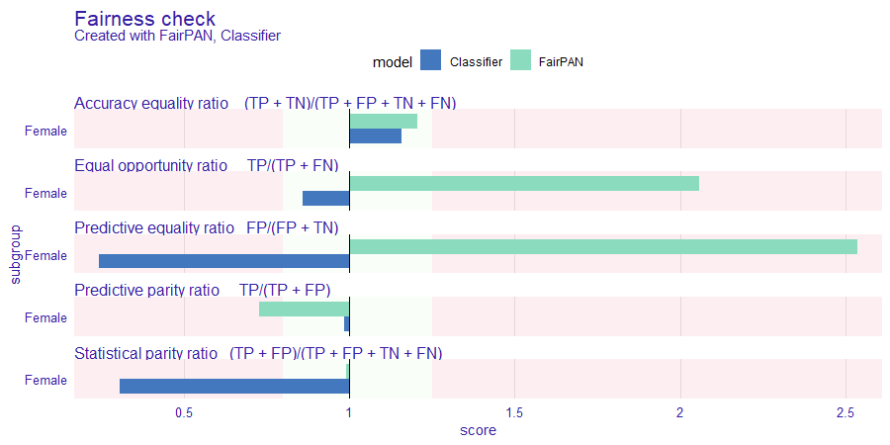
Comparison between Classifier and FairPAN
Notes:
Last visualization presents us the comparison between pretrained classifier and final FairPAN model. As you can see, we’ve got almost perfect score for STP ratio, however it didn’t come to us at no cost. Two metrics, Equal Opportunity Ratio and Predictive Equality Ratio have drastically worsened their own scores, but it can be easily explained. The adult data set is heavily biased and what we actually done during fair training process was generating more True and False positives for Female class in order to make the distributions similar. This changes however makes other metrics change too and it is clearly visible on the displayed plot. It shouldn’t be feared however, because the similarity of distributions is more important for us.

Slide 17
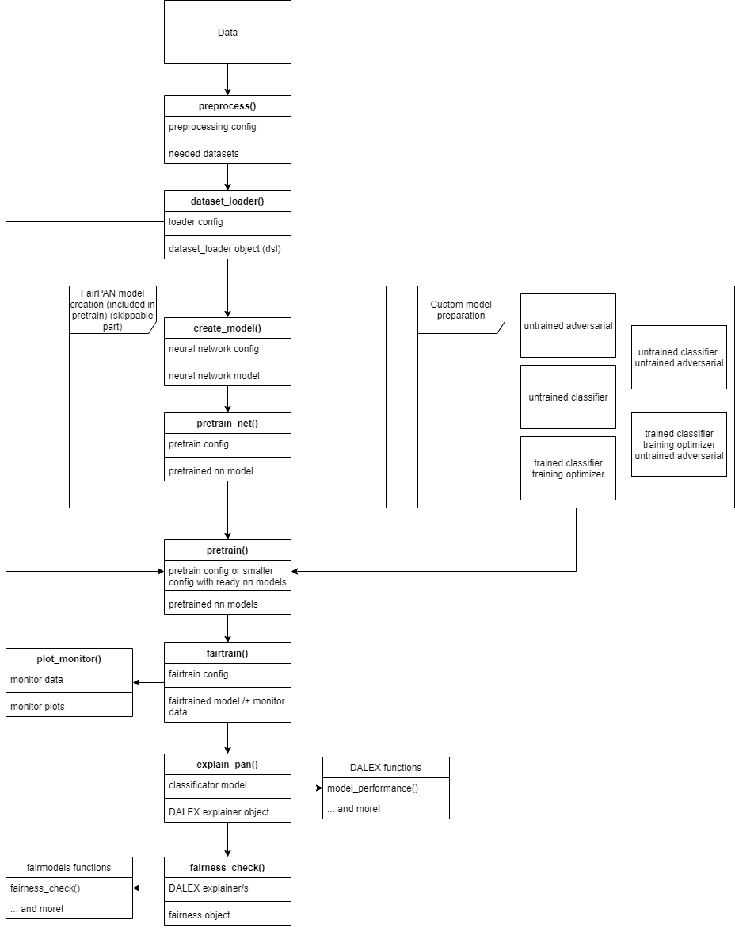
Package workflow
Notes:
In the end, I’d like to present you the structure of the package and say a few words about using it.
First thing that I will repeat couple of times is that the fairpan is really flexible. Inside the workflow, we have many opportunities to provide our own methods instead of relying on the ones implemented inside the package.

Slide 18
Data preparation
Notes:
First example of this we encounter at the very beginning of our workflow. Although fairpan data preprocessing is strongly recommended to use, because it generates all needed datasets, this step is skippable and one can provide data preprocessed by themselves.
After that we have to use a dataset loader function which creates batches, which are needed in the further creation of neural networks.

Slide 19
Model creation and pretrain
Notes:
The next step is the model creation, which is also highly flexible. The user can decide to create both models from the package methods and pretrain them right after the creation, however it is also possible to create them manually and provide them at this step.
One can also decide whether the models given are pretrained or not and provide the combination of models being pretrained or not which are visible on the graph.
As a next step one has to pretrain the networks if they are not pretrained yet and then we can move to the actual fairtrain function.
At this point the user has to tune training parameters such as number of epochs. It is also possible to chose whether model should acquire learning process statistics and if it should print them out.

Slide 20
Obtaining informative results
Notes:
If we choose to save those stats in the next step we can plot them and see if our models work well and achieve desirable results.
After the fairtrain, we can also decide to use explain_pan function, which creates DALEX explainer on which we are able to use all DALEX functions.
We can achieve the same with fairmodels fariness_check where we create fariness object and it can be used in various fairmodels functions and most importantly we can plot the fairness check plot.

Slide 21
FairPAN summary
A competitive bias mitigation technique, due to:
Low performace losses
Applicability to neural networks
Great results in terms of distributions
Intuitive concept based on GANs
Swapping generator with classifier
Adversarial predicts sensitive class
Implemented in R package called ’fairpan’
Intuitive workflow
Flexible functions
Avaiable at: https://github.com/ModelOriented/FairPAN
Notes:
To sum up,
FairPAN is a competitive bias mitigation techinque, thanks to its low performance losses, applicability to neural networks and achieving great results.
It is based on the concept of GANs and efficiently uses it, by swapping the generator with the classifier
Moreover it is followed by an implementation of R open source package that is really flexible and easy to use.

Slide 22
Further Read
fairmodels: A Flexible Tool For Bias Detection, Visualization, And Mitigation, Jakub Wiśniewski, Przemysław Biecek : https://arxiv.org/pdf/2104.00507.pdf
Generative Adversarial Nets, Ian J. Goodfellow: https://arxiv.org/pdf/1406.2661.pdf
Towards fairness in ML with adversarial networks, Stijn Tonks: https://godatadriven.com/blog/towards-fairness-in-ml-with-adversarial-networks/
Fairness in Machine Learning with PyTorch, Henk Griffioen: https://godatadriven.com/blog/fairness-in-machine-learning-with-pytorch/
Achieving Fairness through Adversarial Learning: an Application to Recidivism Prediction, Christina Wadsworth, Francesca Vera, Chris Piech: https://stanford.edu/~cpiech/bio/papers/fairnessAdversary.pdf
Notes:
I can also recommend few articles and blogs for further research according to this topic.
The first article is written by my mentor Jacob and head of MI2DataLab Przemysław Biecek. It describes fairmodels package and contains lots of information about Fairness
Second one descibes the idea of GANs briefly and it is probably the most known article in this area
Next two are blogs, by Stijn Tonks and Henk Griffoen. These two actually implemented the concept of FairPAN before me in their Python scripts and I were deeply inspired by their work
And the last article describes FairPAN concepts from other perspective.

Slide 23
Thank you for your attention
Notes:
Thank you for your attention and I’d like to encourage you to ask some questions about my work.

